Slide 1
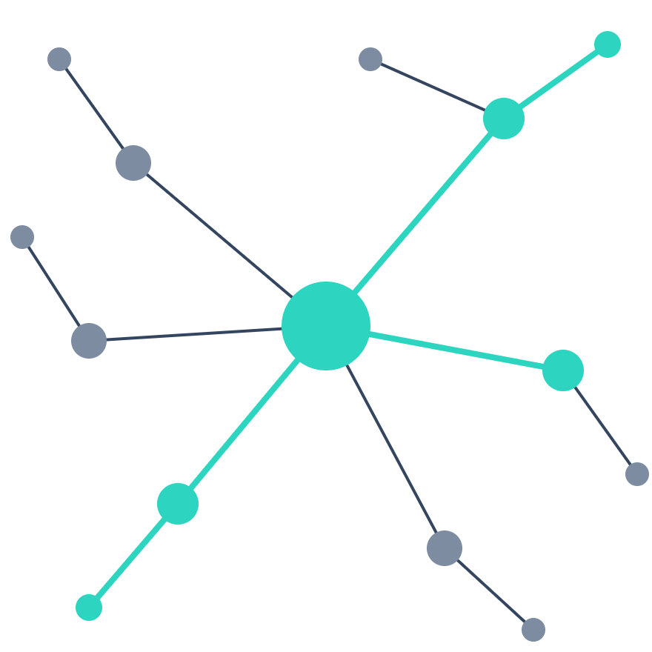
SOCIAL NETWORKS · PAPER PRESENTATION
Predicting, evaluating, and explaining top misinformation spreaders via archetypal user behavior
Enrico Verdolotti, Luca Luceri, Silvia Giordano
Online Social Networks and Media 50 (2025) 100336
PRESENTED BY
Mohsen Mohammadian . Sara Tajernia · Fateme Valipourpasha · Mohammad Choupan · Mahdiye Ebrahimpour
Notes:
Speaker: Sara (slides 1–5, about 2 minutes). Introduce the group and the paper: published in Online Social Networks and Media, 2025, by researchers at SUPSI (Switzerland) and USC ISI. One-sentence pitch: instead of judging content after it spreads, the paper ranks USERS by how likely they are to spread misinformation, using three behavioral archetypes, and explains those rankings with SHAP.

Slide 2
BEFORE WE START · COVID-19, APRIL 2020
“I see the disinfectant, where it knocks it out in a minute… And is there a way we can do something like that, by injection inside or almost a cleaning.”
— Donald Trump, White House coronavirus briefing, 23 April 2020
Next day, the maker of Lysol and Dettol warned that its disinfectants must never be put into the human body.
One high-reach account can push a claim to millions in hours. Can we spot such accounts before they do?
Notes:
Speaker: Sara (slides 1–5, about 2 minutes). OPTIONAL hook slide — delete it if time is short. Open with a familiar example from the COVID-19 period, the same period as the paper's datasets. The quote is from the White House briefing of 23 April 2020; the next day Reckitt Benckiser, maker of Lysol and Dettol, said its products should never be administered into the human body. The point is not the person but the mechanism: a single account with enormous reach can turn a false claim into a viral one. That is exactly what this paper tries to anticipate — by ranking accounts, not posts.

Slide 3
MOTIVATION
Moderation today arrives after the damage is done
01
A misleading post is published
02
It is reshared and spreads widely
03
Users, filters or fact-checkers flag it
RESEARCH QUESTION
04
Labeled, demoted or removed
“Does an account’s behavioral footprint reveal latent signals of misinformation risk?”
By step 4 it has already reached large audiences — false news spreads faster and wider than corrections.
Goal: rank users by their potential to spread misinformation, so platforms can act before content goes viral.
Verdolotti, Luceri & Giordano · OSNEM 2025
3
Notes:
Speaker: Sara. Most moderation is reactive: action is triggered only after a post is flagged, often after it has already gone viral. Studies show false content spreads faster and more broadly than corrections. So the paper flips the perspective from content to users: can past behavior tell us which accounts are likely to spread misinformation next? That enables early-warning, proactive moderation.

Slide 4
RELATED WORK
What earlier work did — and what it missed
GAPS → HOW THIS PAPER ADDRESSES THEM
Content-centered
Spreader roles are vague; amplifiers, who spread but don’t create, are rarely studied
Classify the message: lexical cues, sentiment, LSTMs, transformers, multimodal models.
→ Three formal archetypes
Misses who spreads it and how it travels.
Users treated as static, scored over one fixed time window
→ Time-aware TAI-Score and TASH-Index
User-centered
Profile the spreaders: activity patterns, centrality, GNNs, super-spreader H-Index (DeVerna et al.).
Complex models are black boxes; explainable AI rarely used
→ Interpretable features + SHAP
The direction this paper builds on.
Verdolotti, Luceri & Giordano · OSNEM 2025
4
Notes:
Speaker: Sara. Earlier research follows two lines. Content-centered work asks "is this post misinformation?" using NLP and deep learning; it ignores the people and network dynamics behind the spread. User-centered work studies the spreaders themselves — activity patterns, network centrality, graph neural networks such as SCARLET, and the H-Index-based super-spreader scores of DeVerna et al. The authors point out three gaps: different spreader roles, especially amplifiers, are underexplored; user roles are treated as static; and complex models lack transparency. Each gap maps to one contribution of the paper.

Slide 5
METHOD OVERVIEW
The pipeline in six steps
01 Collect
02 Label
03 Score
COVID-19 reshares from Twitter: VaccinItaly and Multilanguage
Rate each URL’s domain with NewsGuard; ≤ 39 = low-credibility
Six archetype features per user from the observation period
04 Rank
05 Evaluate
06 Explain
One score per archetype, or a Random Forest combining all six
Dismantle the future reshare network: Quality@k and nDCG@k
SHAP shows which archetype drives each user’s rank
Content-agnostic: only a credibility label is needed, so the same pipeline works for images or video.
Verdolotti, Luceri & Giordano · OSNEM 2025
5
Notes:
Speaker: Sara. Before the details, the big picture. Collect reshare data; label each shared link by its domain's NewsGuard credibility; compute archetype-based scores per user from the past; rank users either with one score per archetype or with a machine learning model that combines them; evaluate the ranking on the future network by removing top-ranked users; and finally explain the ML ranking with SHAP. The rest of the talk walks through these steps.
•we introduce a formalization of three distinct behavioral archetypes that characterize users involved in the spread of misinformation
•we enhance a previously proposed influence metric — an Hindex-based score introduced by [18] — by making it time-aware, thus capturing temporal patterns in user activity.
•This refined metric, along with other archetype-specific scores, is integrated into a machine learning framework designed to estimate a user’s potential to disseminate misinformation
By combining features derived from multiple archetypes, the model captures interdependencies between behavioral traits while maintaining interpretability
•Leveraging SHAP-based explainability methods, our approach enables the characterization of individual users in terms of their dominant archetypal behaviors

Slide 6
BEHAVIORAL ARCHETYPES
Three ways an account can drive misinformation
Amplifiers
Coordinated accounts
Super-spreaders
Create little original content but boost others’ posts through extensive resharing.
Groups acting in concert to push the same narratives, simulating consensus.
Post original content that consistently goes viral and attracts heavy engagement.
Signal: how often they reshare low-credibility posts
Signal: synchronized, highly similar resharing behavior
Signal: volume and virality of reshares they receive
Archetypes are not mutually exclusive — one account can show several — and they cover humans and bots alike, since only behavior is used.
Verdolotti, Luceri & Giordano · OSNEM 2025
6
Notes:
Speaker: Sara. (slides 6–9, about 2 minutes). The core idea of the paper: describe spreaders by behavior, not by identity or content. Amplifiers mostly retweet; coordinated accounts behave alike as a group, often in influence campaigns; super-spreaders create original content that goes viral. One user can belong to more than one archetype, and the approach works for both humans and bots.

Slide 7
DATA
Two COVID-19 Twitter datasets, labeled by source credibility
Credibility labeling
VaccinItaly
COVID-19 Multilanguage
Each URL’s domain gets a NewsGuard trust score from 0 to 100.
Italian · Dec 2020 – Oct 2021 · 306 days
Score ≤ 39 → low-credibility (misinformation).
Global · Nov 2020 – Nov 2021 · 372 days
371,586
1,118,697
Only original posts and reshares count — no replies, quotes or self-reshares.
retweets
54,916 original posts
51,962 users
reshares
103,250 original posts
129,507 users
Verdolotti, Luceri & Giordano · OSNEM 2025
7
Notes:
Speaker: Sara. Credibility is assigned at the domain level using NewsGuard ratings; links to domains scoring 39 or less are low-credibility. Because the models only use the credibility label, the method would work for images or video too, given a credibility rating. Two datasets on the same topic but different scope: Italian vaccine discussion and a larger multilingual one. The credibility distribution is bimodal in both, with peaks at very low and very high credibility.
By leveraging two datasets that differ in scale, geographic focus, and linguistic diversity, we ensure that our evaluation captures variability in user behavior and information diffusion dynamics across distinct ecosystems.

Slide 8
RANKING METHODS
One family of ranking scores per archetype
Archetype | Score | How users are ranked
Amplifiers | Repost Count | Number of low-credibility posts the user reshared
 | Early Reposter (EaR) Index | Rewards resharing early in a cascade, especially of later-viral posts
Coordinated | Coord-Centrality | Eigenvector centrality in the co-reshare similarity network
 | Coord-EdgeWeight | Strongest cosine-similarity link to any other user
Super-spreaders | Influence Score | Total reshares received by the user’s low-credibility posts
 | H-Index | Largest h such that h posts each got at least h reshares
 | TAI-Score · TASH-Index | New: time-aware versions of the two scores above
Verdolotti, Luceri & Giordano · OSNEM 2025
8
Notes:
Speaker: Mohsen. Each archetype gets its own ranking. Amplifiers: simply count low-credibility reshares, or reward users who reshare early in the cascade. Coordinated accounts: build a co-reshare network where edges are the cosine similarity of users' resharing activity, then rank by eigenvector centrality or by the strongest edge. Super-spreaders: the state-of-the-art from DeVerna et al. uses retweets received — Influence Score and H-Index, where posts are treated like papers and reshares like citations. The paper's contribution is the time-aware versions, next slide.

Slide 9
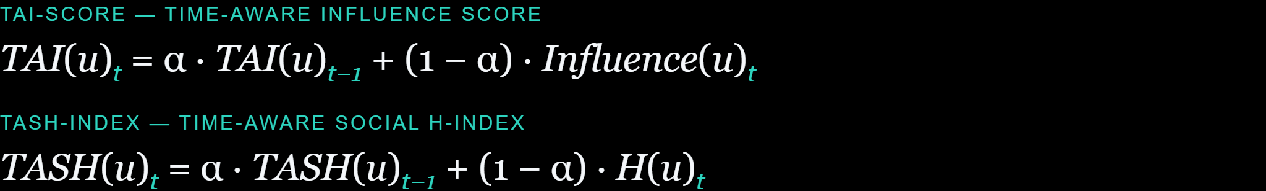
KEY CONTRIBUTION
Time-aware scores: TAI-Score and TASH-Index
Split time into slots of δ days, compute the score in each slot, smooth with an exponential moving average. The first slot’s value starts the average.
Why time-aware?
The α knob
Grid search on nDCG
A fixed window is arbitrary and biased by posting frequency.
α = 1: only the first slot. α = 0: only the latest slot.
TASH: α = 0.5, δ = 14 days
TAI: α = 0.6, δ = 18 days
Verdolotti, Luceri & Giordano · OSNEM 2025
9
Notes:
Speaker: Mohsen. The static Influence Score and H-Index are computed over one fixed window, which is arbitrary. The paper makes both time-aware. Split the observation period into slots of delta days, compute the score in each slot, and combine slots with an exponential moving average: the new value is alpha times the previous smoothed value plus one minus alpha times the current slot's score. TAI-Score smooths the Influence Score (total reshares received); TASH-Index smooths the H-Index. A higher alpha gives more weight to the past, a lower alpha to recent activity. Grid search on nDCG chose alpha 0.5 and 14-day slots for TASH, alpha 0.6 and 18 days for TAI. TASH is cheap, interpretable and can be updated incrementally with every reshare.

Slide 10
MACHINE LEARNING RANKING
Combining all archetypes in one learning-to-rank model
1 · INPUT FEATURES
2 · MODEL
3 · TARGET
4 · EXPLAIN
Repost Count · EaR-Index
Coord-Centrality · Coord-EdgeWeight
TAI-Score · TASH-Index
Random Forest regression — pointwise ranking (best of several off-the-shelf models)
User strength: total low-credibility reshares the user is involved in, as author or resharer
SHAP shows which archetype drives each rank
→
→
→
Temporal split, no leakage: the first 80% of reshares (in time order) are the observation period for training; the last 20% are the evaluation period.
Verdolotti, Luceri & Giordano · OSNEM 2025
10
Notes:
Speaker: Mohsen(slides 10–12, about 2 minutes). Beyond single-archetype scores, the authors ask whether combining them helps. Each user becomes a vector of the six archetype features. Ranking is framed as pointwise learning-to-rank: a regression that predicts a user's future "strength" in the misinformation reshare network. Random Forest performed best. The model is deliberately restricted to archetype features, so SHAP explanations map directly to archetypes. Data is split in time order, 80/20, so the model never sees the future.

Slide 11
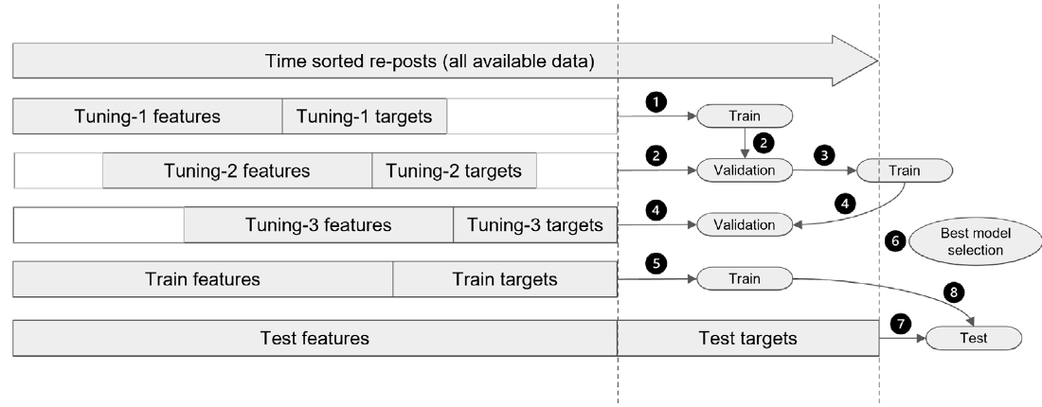
MODEL TUNING
Sliding-window validation, always forward in time
MODELS COMPARED (TABLE C.3)
Model | @3 | @10 | nDCG
Linear | 0.955 | 0.851 | 0.890
Random Forest | 0.970 | 0.939 | 0.910
XGBoost | 0.750 | 0.850 | 0.864
Neural net | 0.970 | 0.910 | 0.900
Windows defined by number of reshares, not days
Each fold: features from the past, targets from the next 20%
Best setting = best average across folds, then final train → test
Random Forest: most stable, handles the skewed target and correlated features.
Fig. C.13 and Table C.3 · Appendix C
11
Notes:
Speaker: Mohsen.
Normal k-fold would shuffle time and leak the future into training. Instead, all reshares are sorted in time and the authors use sliding windows: each tuning fold takes features from an earlier block and targets from the following 20% of events. Windows are defined by number of reshare events (sample-wise data split), not by days. The hyper-parameter setting with the best average across folds is chosen, retrained on the train fold and evaluated once on the test fold. Among the models tried, Random Forest had the best overall nDCG and was the most stable; it copes well with the very skewed target and correlated features.

Slide 12
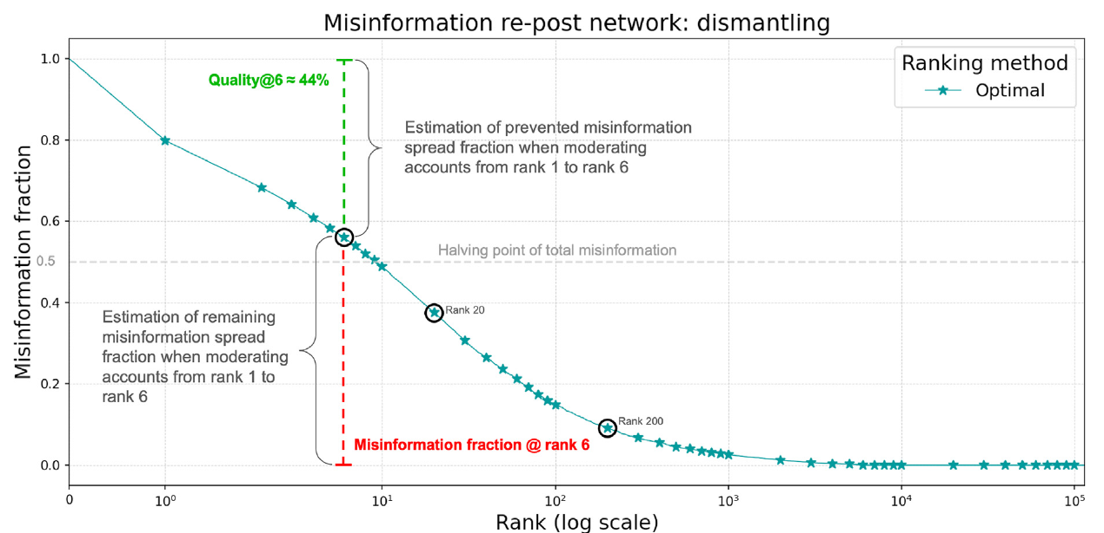
EVALUATION
Evaluation by dismantling the misinformation network
Reshare network from the test period: edge A → B weighted by how many of A’s low-credibility posts B reshared.
Remove users in ranked order and measure how much misinformation volume disappears.
Quality@k — share of misinformation removed by moderating the top-k users
nDCG@k — agreement with the ground-truth ranking by node strength
Fig. 2 — optimal ranking: removing just the top 6 users cuts ≈ 44% of misinformation.
Verdolotti, Luceri & Giordano · OSNEM 2025
12
Notes:
Speaker: Mohsen. To compare rankings fairly, the authors build the low-credibility reshare network from the unseen test period and remove users one by one following each ranking — simulating deplatforming. The curve shows how much misinformation remains. Quality@k is the fraction removed by the top k users; nDCG@k measures how well the predicted order matches the true order by node strength. The figure shows the optimal curve: a handful of users account for a large share of misinformation. Note: users seen only in the test set cannot be ranked, so about 2.9% of misinformation can never be removed.
whether a user with high misinformation dissemination is positioned before users with lower contribution.

Slide 13
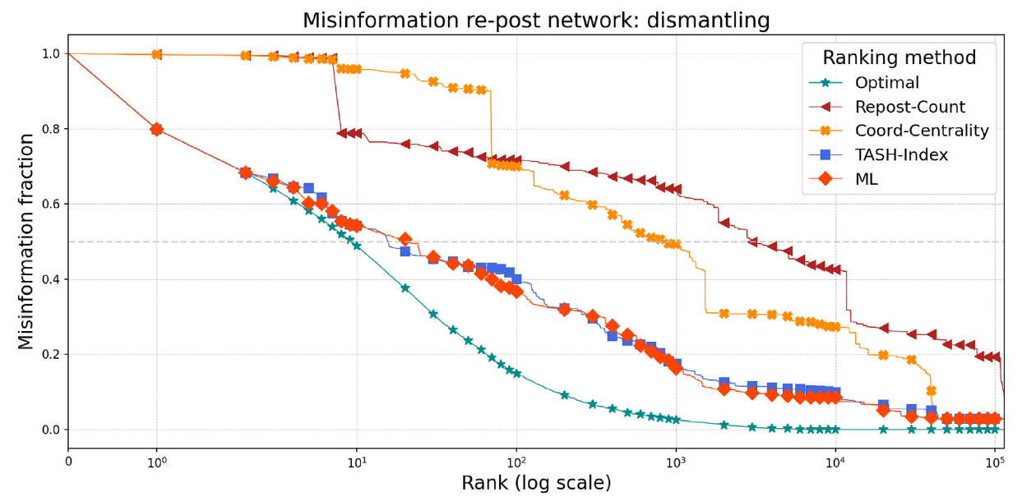
RESULTS · RANKING PERFORMANCE
ML and TASH-Index track the optimal curve
Lower curve = better. Each point is one more user removed.
ML and TASH-Index stay close to optimal for top ranks.
Amplifier and coordination scores alone lag far behind.
Fig. 3 · VaccinItaly dataset
13
Notes:
Speaker: Mohsen. This compares the best method of each archetype against the optimal ranking. The left part of the curve matters most in practice, since platforms can only act on a few accounts. ML and TASH-Index — which is grounded in the super-spreader archetype — almost overlap and stay close to optimal. Why? The most impactful nodes have high strength (many incoming and outgoing reshares), and super-spreader scores capture exactly that. Repost Count and Coordination-Centrality alone perform much worse.
In practical terms, we are most interested in the early portion of each curve: the left-hand side indicates how much misinformation is mitigated by removing only the top-ranked users.
These removals assume complete blocking of users, without modeling the dynamic effects of moderation on user behavior or network structure.
Nodes with high strength, therefore, indicate users who are highly effective at spreading content and receive substantial engagement from others. Therefore, ranking strategies that prioritize such properties, such as the volume of reshares received, naturally result in better performance.
these results aligns with previous findings that show that a limited number of users (small 𝑘) is responsible for a large amount of misinformation (Pareto law)

Slide 14
RESULTS · TABLE 1
Top-k performance on VaccinItaly
@k | ML nDCG | ML Quality | TASH nDCG | TASH Quality | TAI nDCG | TAI Quality | H-Index nDCG | H-Index Quality | Influence nDCG | Influence Quality
3 | 0.963 | 34.0% | 0.949 | 33.3% | 0.938 | 32.6% | 0.892 | 32.6% | 0.892 | 32.6%
5 | 0.967 | 39.8% | 0.912 | 35.7% | 0.901 | 35.0% | 0.858 | 35.0% | 0.865 | 35.7%
10 | 0.939 | 45.8% | 0.931 | 45.8% | 0.873 | 40.3% | 0.832 | 40.4% | 0.824 | 40.4%
20 | 0.890 | 49.0% | 0.906 | 52.8% | 0.848 | 49.2% | 0.790 | 43.7% | 0.783 | 43.2%
100 | 0.848 | 62.3% | 0.832 | 60.0% | 0.829 | 65.8% | 0.800 | 66.7% | 0.793 | 66.9%
1000 | 0.841 | 81.8% | 0.782 | 82.4% | 0.774 | 83.9% | 0.742 | 81.7% | 0.735 | 82.7%
Overall | 0.904 | 97.1% | 0.868 | 97.1% | 0.855 | 97.1% | 0.829 | 97.1% | 0.821 | 97.1%
ML wins at small k; TASH-Index is a close second with a simple formula; TAI-Score gives the best Quality at broad scale (k = 1000). Same pattern on the Multilanguage dataset.
Bold teal = best per row · Table 1, VaccinItaly
14
Notes:
Speaker: Mohsen. Numbers behind the curves. ML has the best overall nDCG, 0.904, and the best scores for the top 3 to 10 users: removing just the top 10 cuts about 46% of misinformation. TASH-Index is almost as good — and even best at k = 20 — while being much simpler and cheaper: a clear trade-off between complexity and effectiveness. At larger scale, TAI-Score reaches the best Quality, 83.9% at k = 1000. Static scores, H-Index and Influence Score, consistently underperform, which shows that temporal dynamics matter.

Slide 15
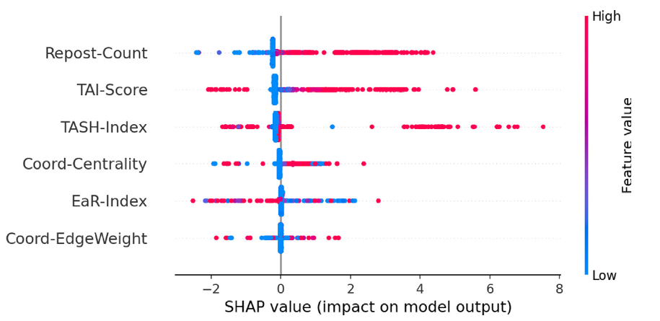
RESULTS · EXPLAINABILITY
What drives the model overall: SHAP summary
#1
Repost Count (amplifiers): frequent resharing is the strongest signal
#2–3
TAI-Score and TASH-Index (super-spreaders)
Coordination and EaR features contribute less.
Fig. 4 — one dot per user · red = high feature value · right of 0 = pushes the user up the ranking
Verdolotti, Luceri & Giordano · OSNEM 2025
15
Notes:
Speaker: Mohammad. How to read the plot: each dot is a user; its color is the feature value, red high and blue low; its position is how much that feature pushed the user's predicted rank up (right) or down (left). Surprisingly, the most influential feature is Repost Count, an amplifier feature: users who frequently reshare low-credibility content are strongly pushed up. Next come TAI-Score and TASH-Index, the super-spreader features. Coordination features and the Early Reposter Index matter less overall.

Slide 16
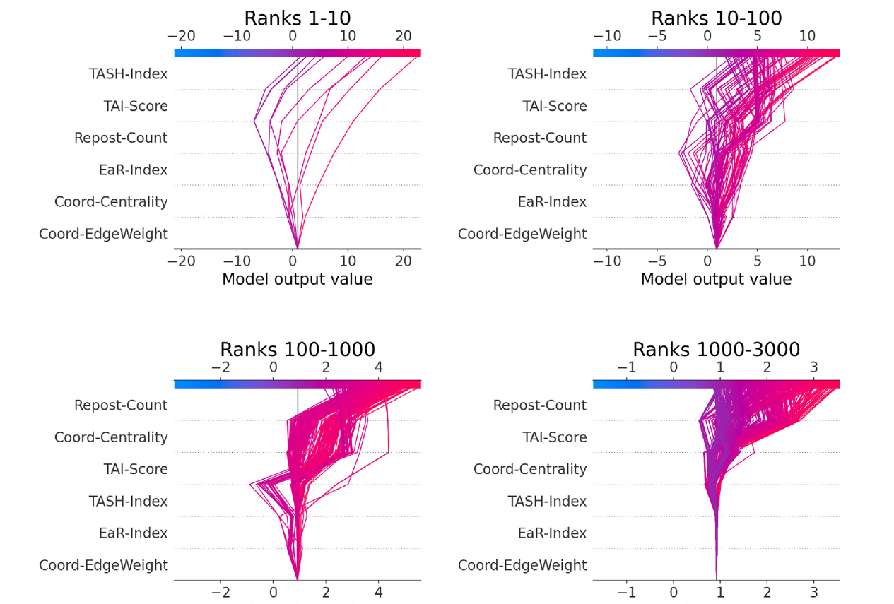
RESULTS · EXPLAINABILITY BY RANK
Different archetypes matter at different ranks
1–10
TASH & TAI lead → super-spreaders
10–100
Repost Count and Coord-Centrality join → hybrid users
100–1000
Repost Count leads → amplifiers, with coordination rising
1000–3000
Repost Count still first → the long tail
Super-spreaders start the cascade; amplifiers and coordinated accounts keep it going.
Fig. 5 · SHAP decision plots per rank interval
16
Notes:
Speaker: Mohammad. Fig. 5 splits the SHAP analysis by rank interval. Each line is a user, built up feature by feature from the bottom to the final prediction; features are ordered by importance in that band. In the top 10, the model relies on TASH-Index and TAI-Score: the highest-ranked users behave like super-spreaders. Between 10 and 100, Repost Count and Coordination-Centrality start to matter: hybrid profiles. From 100 down, Repost Count dominates and coordination becomes more relevant: amplifiers and coordinated accounts. So super-spreaders ignite the spread, while amplifiers and coordinated accounts sustain it. Hand over to Mohsen.

Slide 17
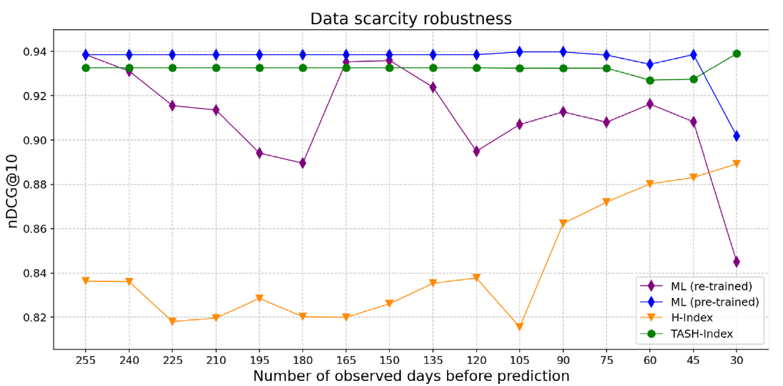
RESULTS · DATA SCARCITY
How much history does each model need?
TASH-Index
Stable at ≈ 0.93 even with 30 days
ML, pre-trained
Stable; drops only at 30 days
ML, re-trained
Unstable as data shrinks
H-Index
Lowest throughout
Fig. 6 — nDCG@10 as the observation window shrinks from 255 to 30 days.
Less data needed → earlier intervention
17
Notes:
Speaker: Mohammad(slides 17–21, about 2 minutes). In practice, the more data a method needs, the longer we wait before acting. The authors shrink the observation window from 255 to 30 days. TASH-Index stays remarkably stable and beats the plain H-Index everywhere. The pre-trained ML model also stays strong and only degrades at 30 days, when feature vectors become too sparse. Retraining ML from scratch on small windows makes it unstable. So TASH is a strong choice for early warning with little data.

Slide 18
IMPLICATIONS
From rankings to moderation: one action per tier
TOP RANKS
Targeted, preventive actions
Super-spreaders
Closer moderation scrutiny, fact-checking overlays, temporary content restrictions
MID AND LOWER RANKS
Systemic measures
Amplifiers and coordinated accounts
Limit amplification of their posts, reduce recommendation exposure, add friction: share limits, warning prompts
Decision support, not automatic bans: humans stay in the loop, with auditability and a right to appeal.
Verdolotti, Luceri & Giordano · OSNEM 2025
18
Notes:
Speaker: Mohammad. Because SHAP tells us why a user is ranked high, platforms can match the intervention to the behavior. Top-ranked users who behave like super-spreaders could get targeted preventive actions: more moderation scrutiny, fact-checking overlays or temporary restrictions. Users further down, whose behavior is repetitive or coordinated resharing, are better handled with systemic measures: limiting how far their posts are amplified, adjusting recommendation exposure, or adding friction like share limits and warning prompts. The authors stress this is decision support in a human-in-the-loop system, with safeguards like auditability and appeal.

Slide 19
DISCUSSION
Limitations, our critique and future work
Limitations
Our critique
Future work
Only direct reshares; who actually saw a post is unknown
Credibility judged per domain, not per post
New users can’t be ranked: 2.9% (VaccinItaly) and 4.8% (Multilanguage) of misinformation is never removable
Static dismantling ignores how users react to moderation
Intent is ignored: careless sharers and campaigners look alike
Users missing from the test period count as zero harm
A pre-trained model may drift as behavior changes
Twitter and COVID-19 only; other platforms and topics untested
Integrate TASH into graph neural networks
Adaptive tuning of α and δ, e.g. Bayesian optimization
Multi-platform data; inductive models for new users
Simulations of interventions’ long-term effects
Verdolotti, Luceri & Giordano · OSNEM 2025
19
Notes:
Speaker: Mohammad. Limitations stated by the authors: APIs only expose direct reshares, not exposure; credibility comes from domain ratings; models can only rank users seen in training, so 2.9% of misinformation in VaccinItaly and 4.8% in Multilanguage can never be removed; and the dismantling is static, while real moderation changes behavior. Our own critique: the approach deliberately ignores intent, so an accidental sharer and a campaign account are treated the same — the authors suggest intent-aware methods as a complement; users who were active in training but silent in the test period get a ground-truth score of zero; a model pre-trained on one period may drift as behavior changes; and everything is tested on Twitter and COVID-19 only. Future work: TASH inside GNNs, adaptive tuning, multi-platform data with inductive models, and simulation environments for interventions.

Slide 20
TAKEAWAYS
What we learn from this paper
1
A few users drive most misinformation. Super-spreaders dominate the top ranks; amplifiers and coordinated accounts sustain the spread further down.
2
Time matters. The simple, interpretable TASH-Index nearly matches ML and stays robust with little data.
3
Explainable rankings support human moderators — closer review for top spreaders, friction such as share limits for amplifiers.
Notes:
Speaker: Mohammad. Three things to remember. First, misinformation is concentrated: a small group of super-spreaders starts it, and amplifiers and coordinated accounts keep it going. Second, temporal dynamics matter: TASH-Index is cheap, interpretable and robust, nearly as good as the ML model. Third, these rankings are meant as decision support in a human-in-the-loop system, with safeguards like auditability and appeal — not automatic bans.

Slide 21
Thank you
Questions?
Notes:
Speaker: Mohsen. Thank the audience and open the floor for questions.

